Slide 1
Unmanned ground vehicle
PREPARED BY: MUHAMMAD GHAZALI BIN RAMLY

Slide 2
history

Slide 3
HISTORY OF UGVs
The first military UGV was probably the Russian TT-26 “Teletank,” which the Red Army developed in the 1930s. Two battalions of the Teletanks, which could be controlled remotely from another tank almost a mile away, were deployed in the Winter War against Finland in 1940.
The teletanks could be mounted with machine guns, flamethrowers, and bombs. Closely thereafter, the German army unveiled the Goliath, a French-designed remote-control mini-tank that could be driven towards targets and remotely detonated.
Despite their humble capabilities and their tendency to break, 7,564 Goliaths were produced. The Second World War saw the development of a number of similar single-use weapons platforms. Though it is tempting to define these as UGVs, the fact that they served exclusively single use bombs, rather than weapons delivery systems, means that they were more like precision-guided munitions than unmanned ground vehicles.
A parallel would be to call a Hellfire missile a drone, rather than the Predator or Reaper that fires the missile and then returns to base to prepare for another mission.

Slide 4
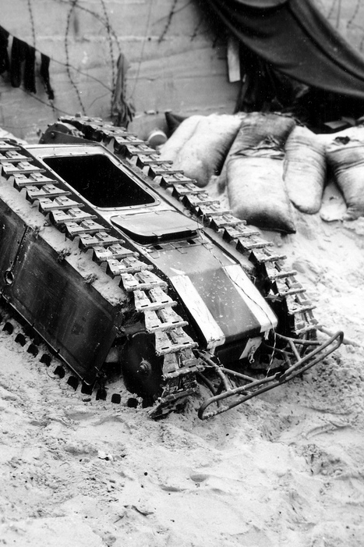
The UGV did not take its modern form until 1972, when the British Military developed the Morfax Wheelbarrow, the first remote controlled Explosive Ordinance Disposal unit.
The Wheelbarrow was created in response to the increasing loss of life and property that resulted from the activities of the Irish Republican Army. The Wheelbarrow laid the basic template for EOD robots, which are the most prolific unmanned ground vehicles in modern militaries.

Slide 5
Robot system architecture

Slide 6
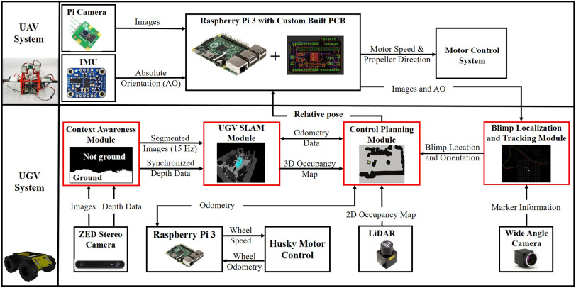
ROBOT SYSTEM ARCHITECTURE

Slide 7
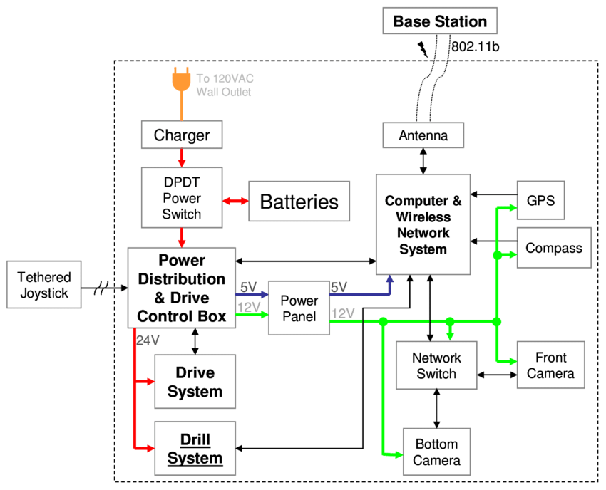
ROBOT SYSTEM ARCHITECTURE

Slide 8
Robot design vs task

Slide 9
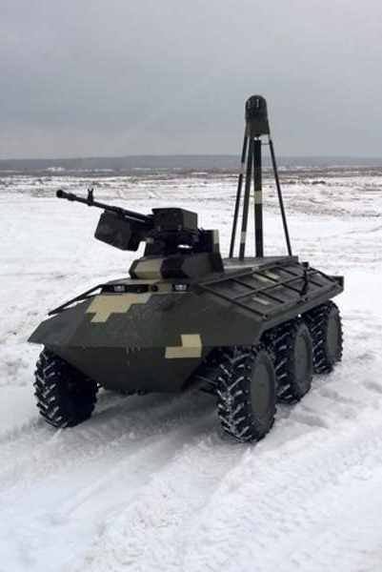
1. MILITARY
Military UGV uses include EOD (explosive ordnance disposal), equipment carrying, forward reconnaissance, mobile weapons platforms and manned-unmanned teaming. Many UGV platforms can be quickly reconfigured to perform multiple roles.
In keeping with recent trends, unmanned military vehicles are growing increasingly smarter and smaller. Small unmanned ground vehicle technologies help make battlefields safer for humans.
These systems demonstrate a robust ability to undertake several high-pressure tasks, including firefighting, public safety, and the delivery of supplies and medications to patients in remote areas.
They are especially helpful in defense applications, as their miniature size allows them to reach and operate in re mote locations that may be inaccessible to humans.

Slide 10
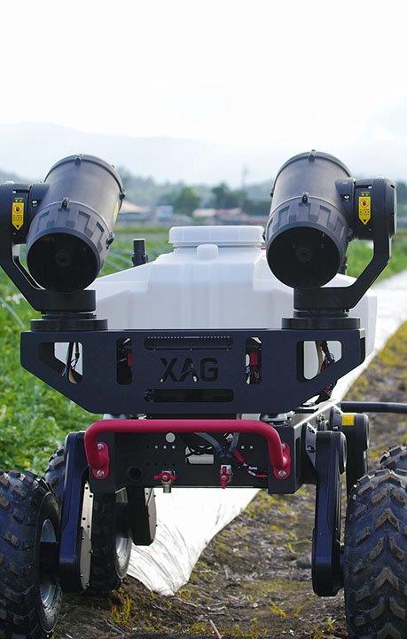
2. AGRICULTURE UGV
The commercial availability of GNSS has provided easy ways to configure autonomous vehicles or navigation systems to assist drivers in outdoor environments, especially in agriculture, where many highly accurate vehicle steering systems have become available.
These systems aid operators in the precise guidance of tractors using LIDAR (light/laser detection and ranging) or GNSS technology but do not endow a vehicle or tool with any level of autonomy.
Nevertheless, other critical technologies must also be incorporated to configure UGVs, such as the safety systems responsible for detecting obstacles in the robots’ path and safeguarding humans and animals in the robots’ surroundings as well as preventing collisions with obstacles or other robots.
Finally, robot communications with operators and external servers (cloud technologies) through wireless communications that include the use of cyber-physical systems (CPSs) and Internet of things (IoT) techniques will be essential to incorporate decision-making systems based on big data analysis.
Such integration will enable the expansion of decision processes into fields such as machine learning and artificial intelligence.

Slide 11
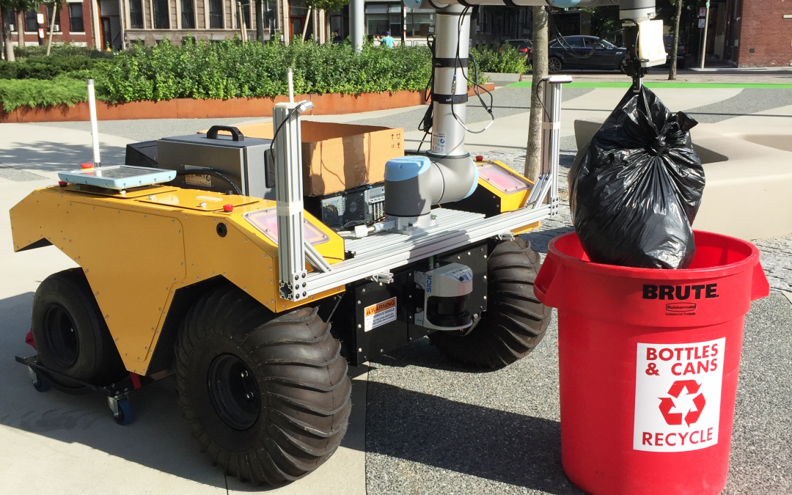
3. COMMERCIAL UGV
UGVs are used for a wide range of civilian applications such as urban search and rescue, firefighting, nuclear plant operations, crowd control and agricultural spraying and harvesting.

Slide 12
ACTUATOR AND LOCOMOTION

Slide 13
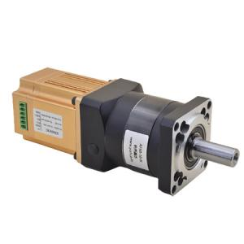
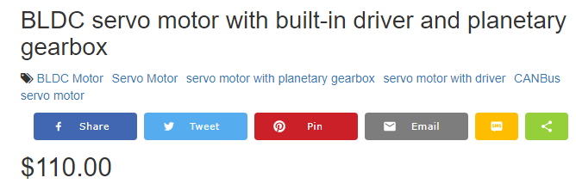
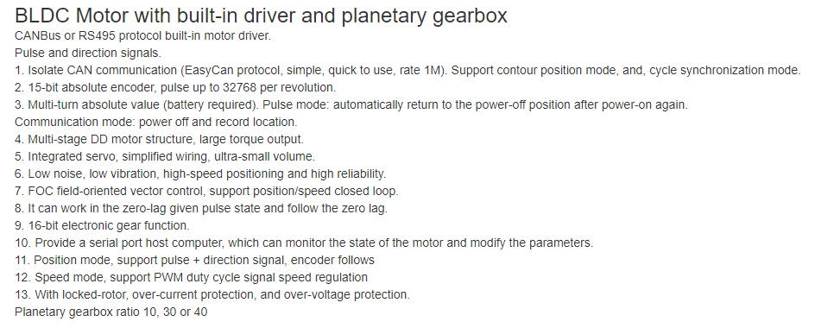
1. SERVO MOTOR

Slide 14
Navigation system and controller

Slide 15
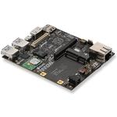
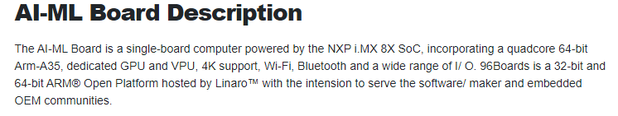
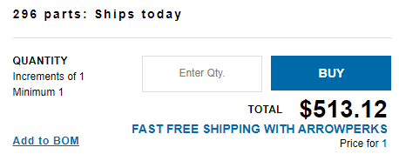
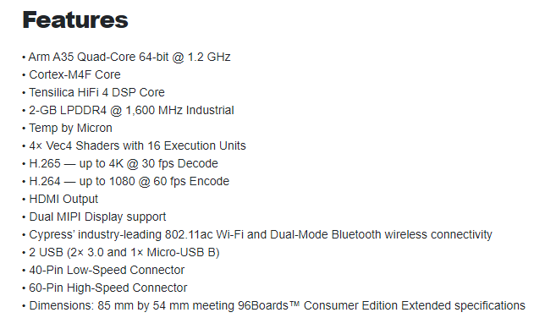
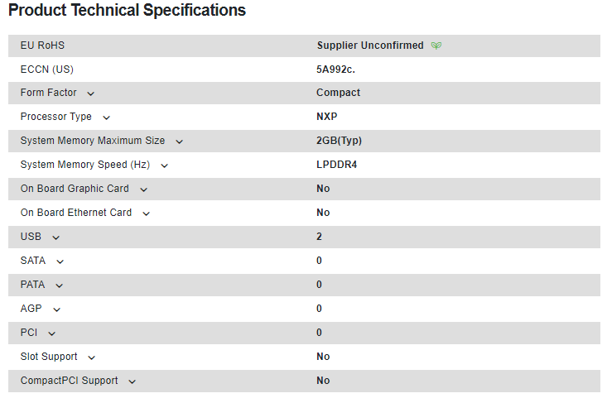
1.. SINGLE BOARD COMPUTER

Slide 16
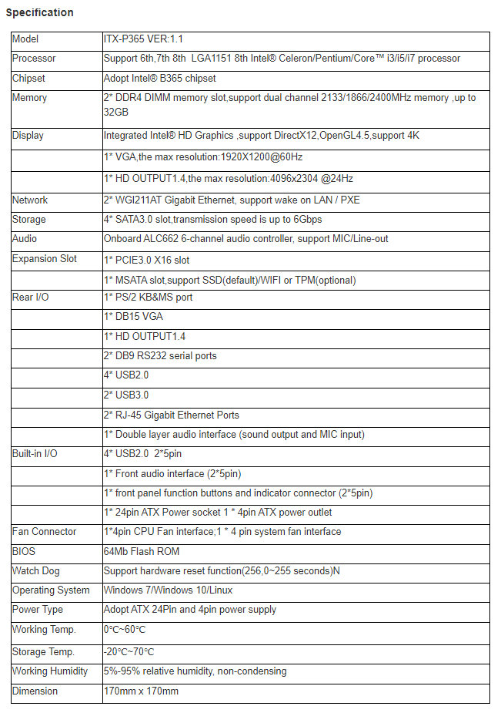
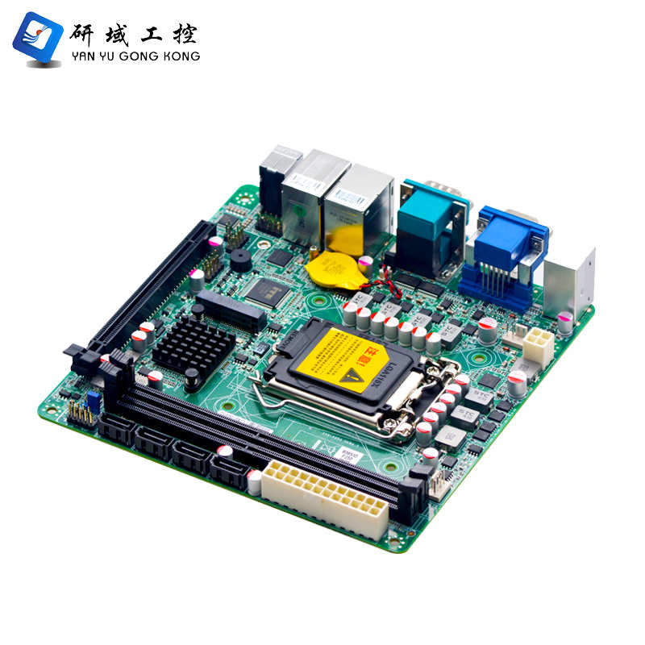
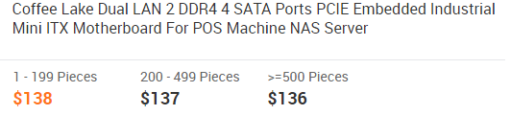
2. MINI ITX

Slide 17
Data collection

Slide 18
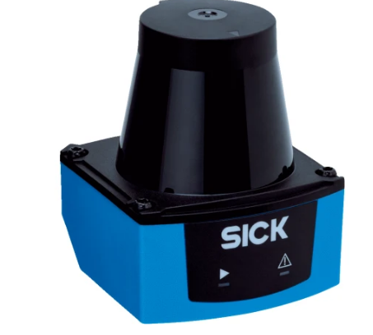
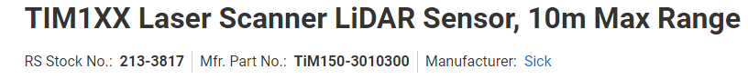
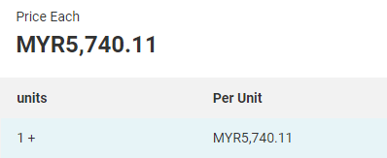
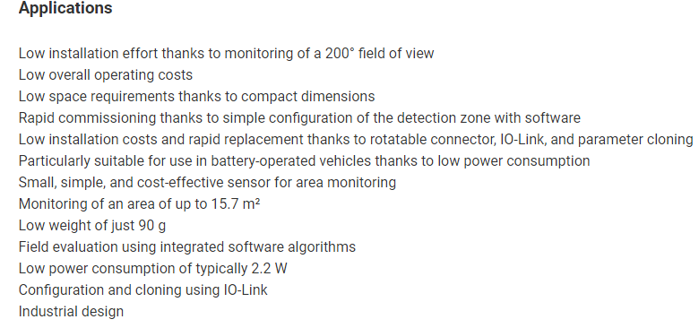
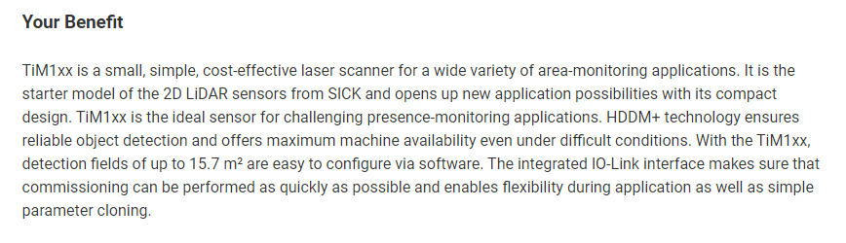
1. LIDAR

Slide 19
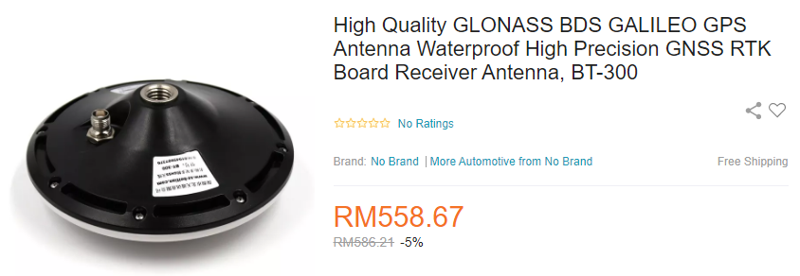
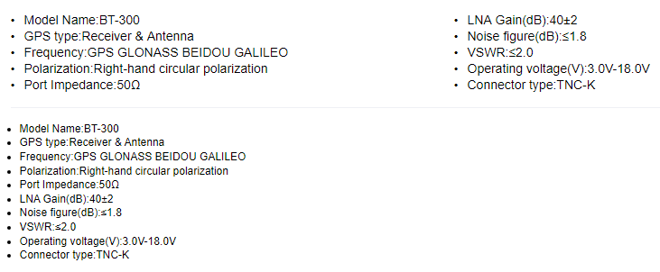
2. RTK GPS

Slide 20
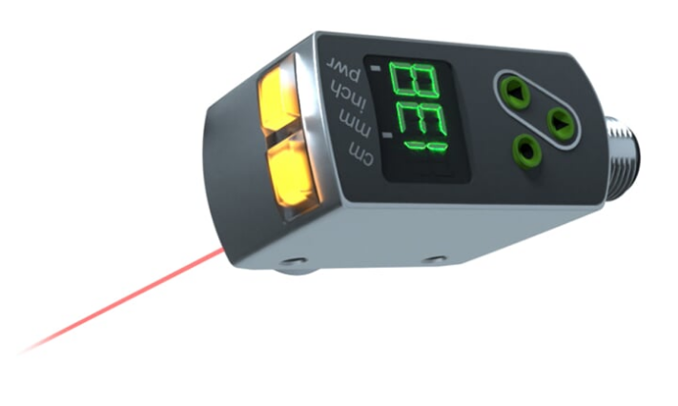
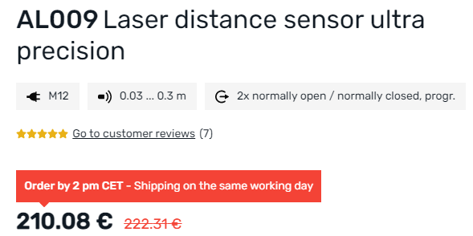
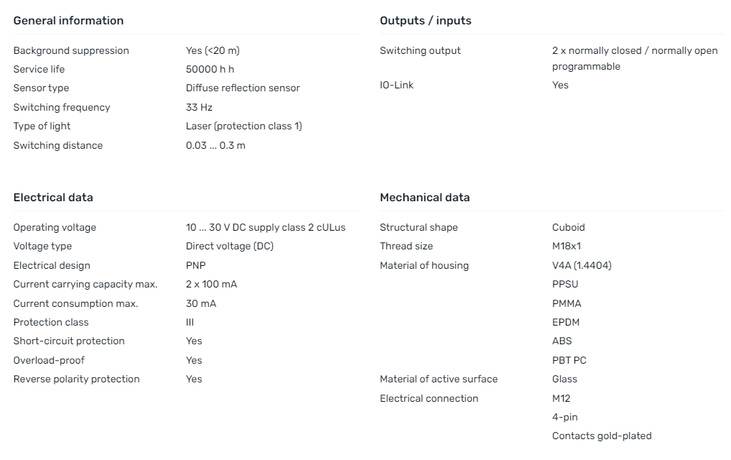
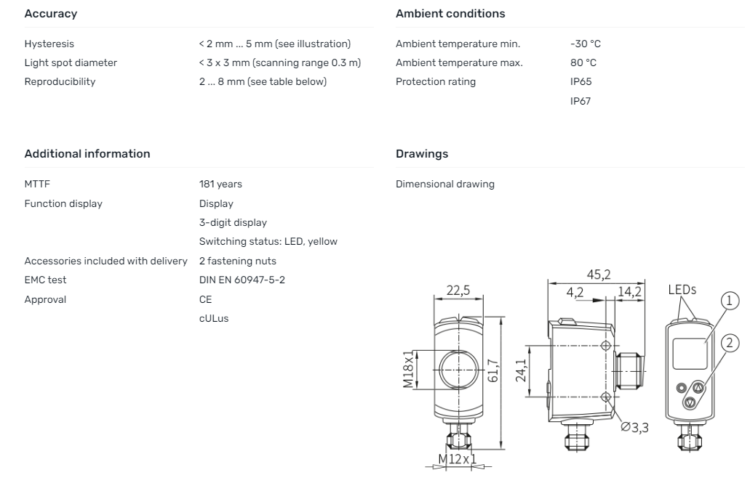
3. Laser Range Finder IMU

Slide 21
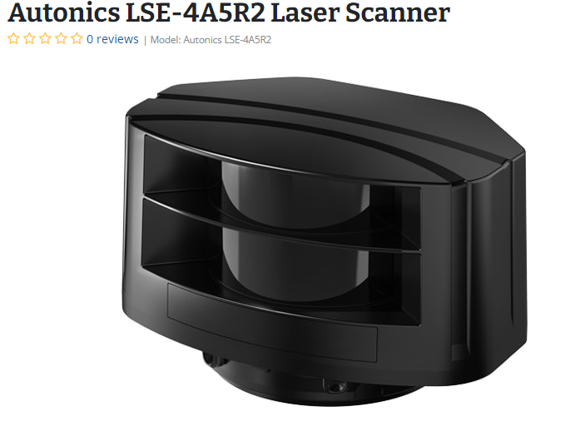

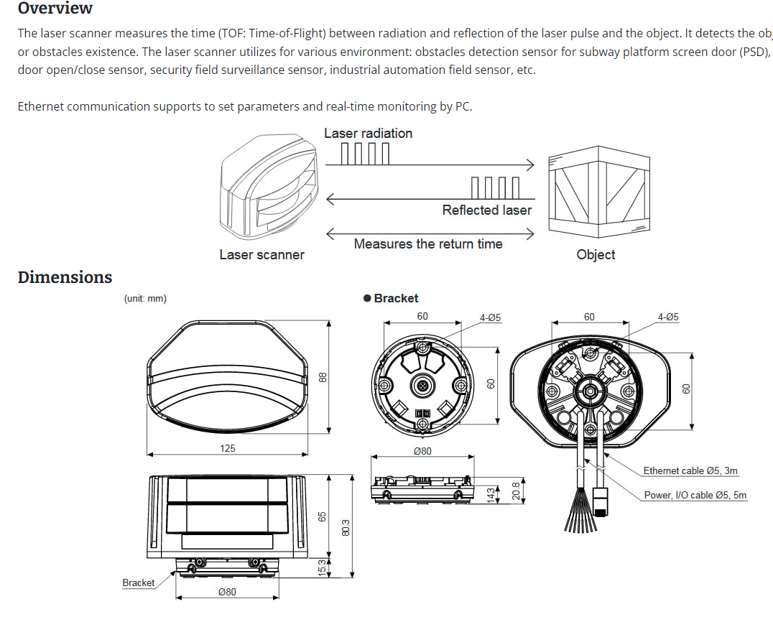
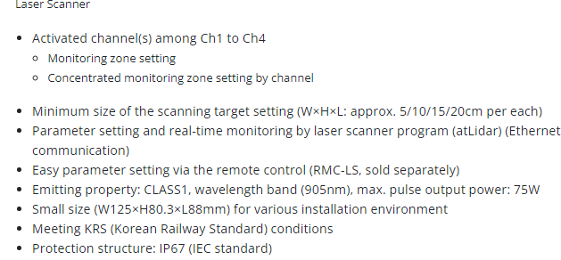
4. Laser Scanner Camera

Slide 22
Data transmission

Slide 23
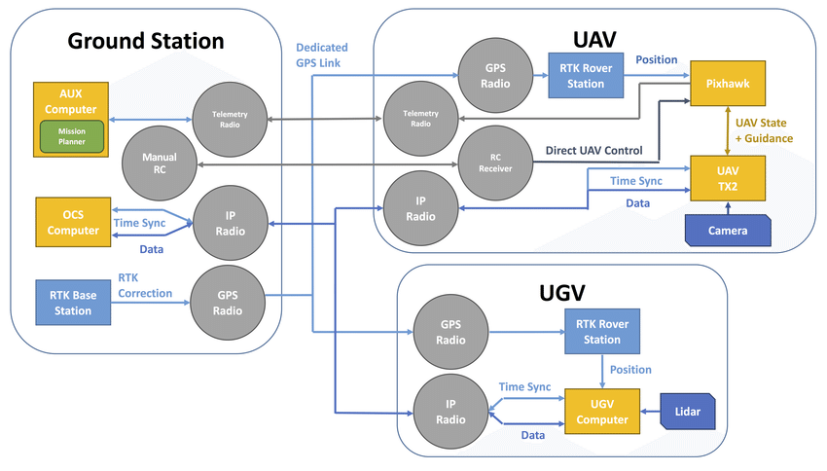
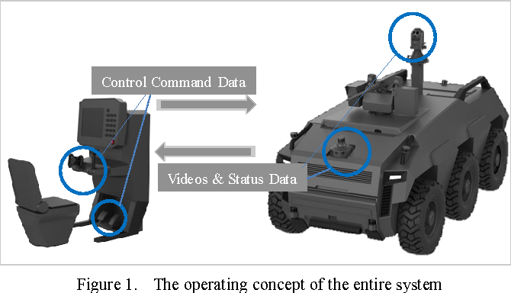
1. Wireless Network Station

Slide 24
Power system management

Slide 25
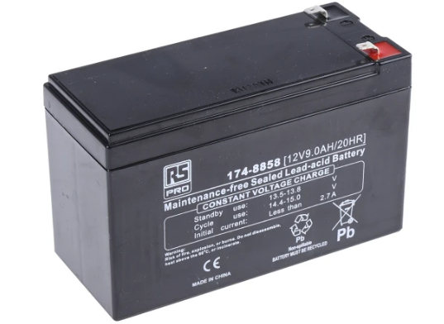

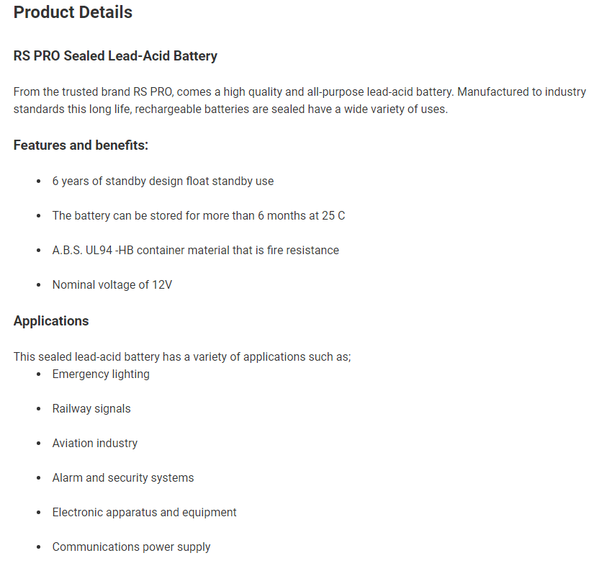
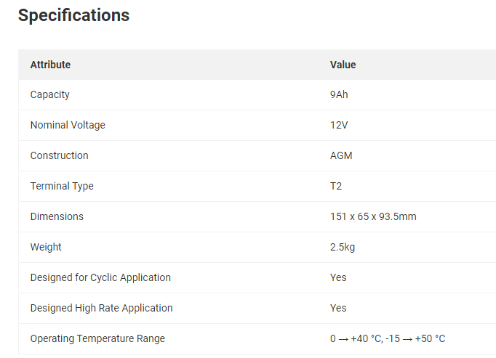
1. Lead Acid Battery

